Slide 1
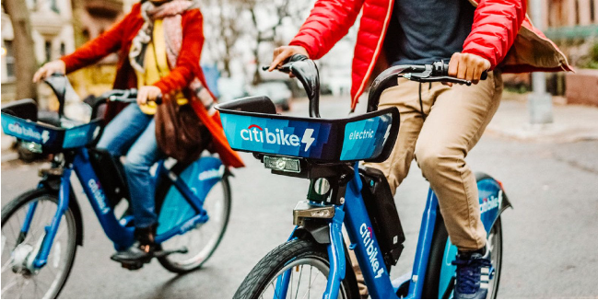
Project 2 - Destination Station BACKROW TEAM : John S Chapek Claudia Palmer Alexandra solano Donatienne Noel

Slide 2
Market Analysis
During the Market Analysis stage, the team took a look at the CitiBike app for :
Current state
Why renters were renting at peak hours , but not during the daytime
Suggested Future State
Proposed Solution to close the Gap(s)

Slide 3
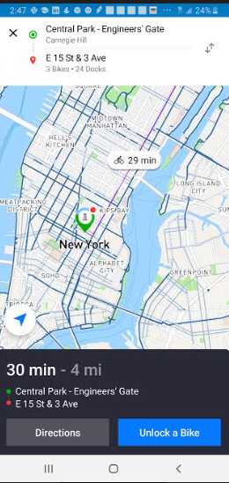
Current State
Citibike renters :
Unable to plan their activities
Current Citibike App allows to map route
Provides renters only with the duration of their trip,

Slide 4
Future State
Citibike renters :
Increase the rate of Renters by 80% during the day – slow hours
Provide renters an added value service

Slide 5
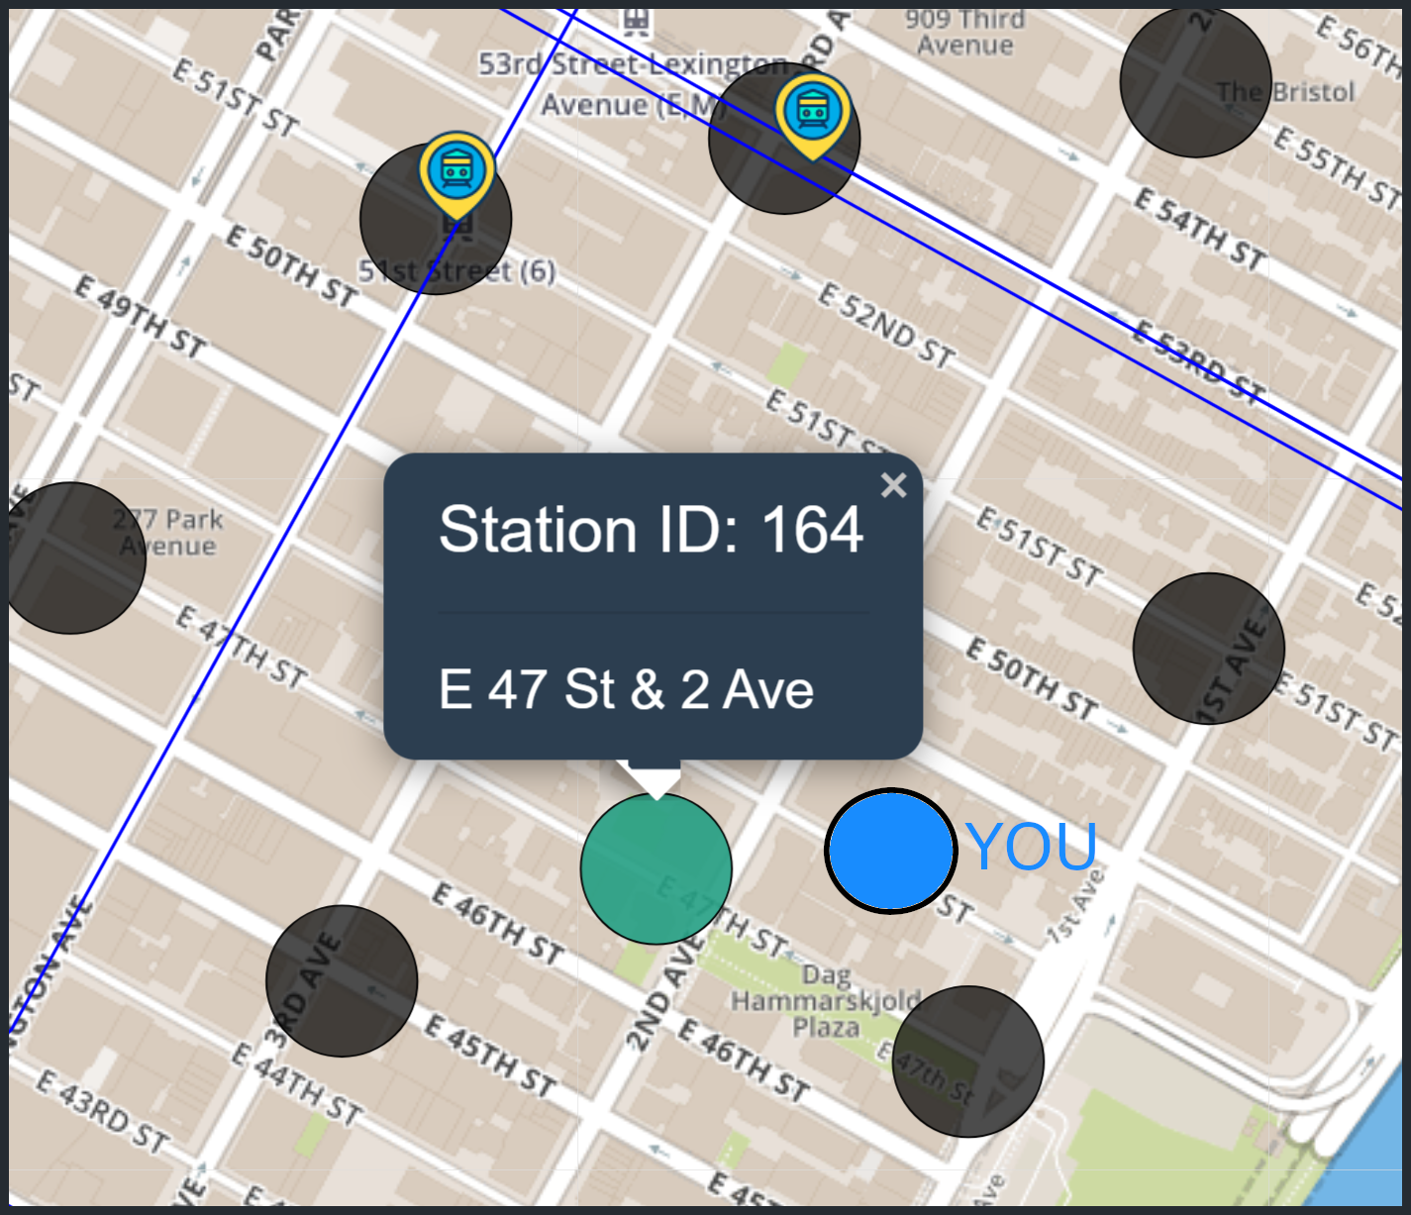
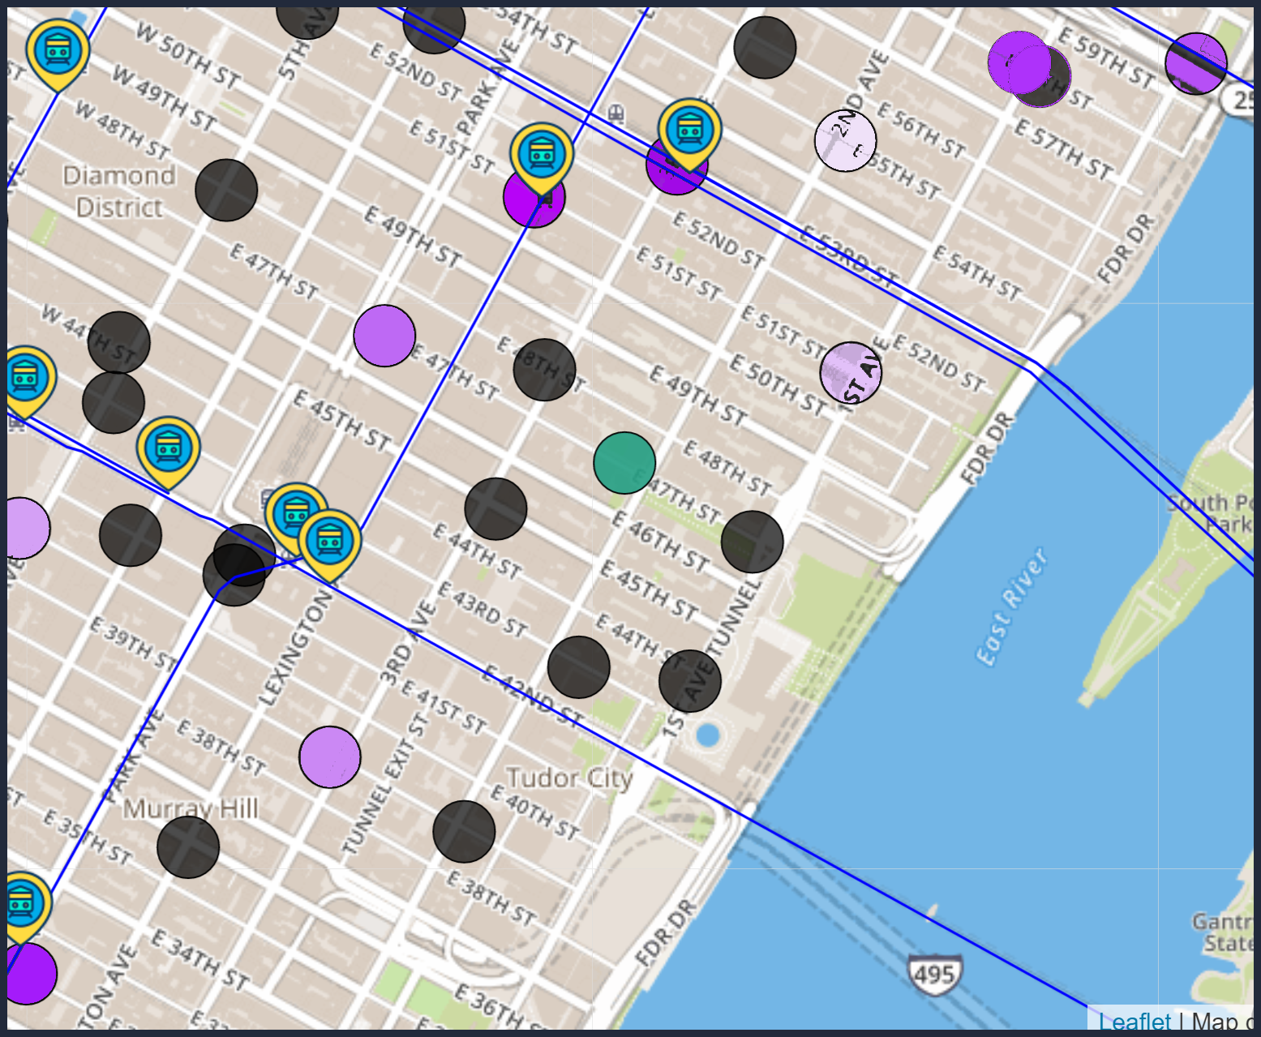
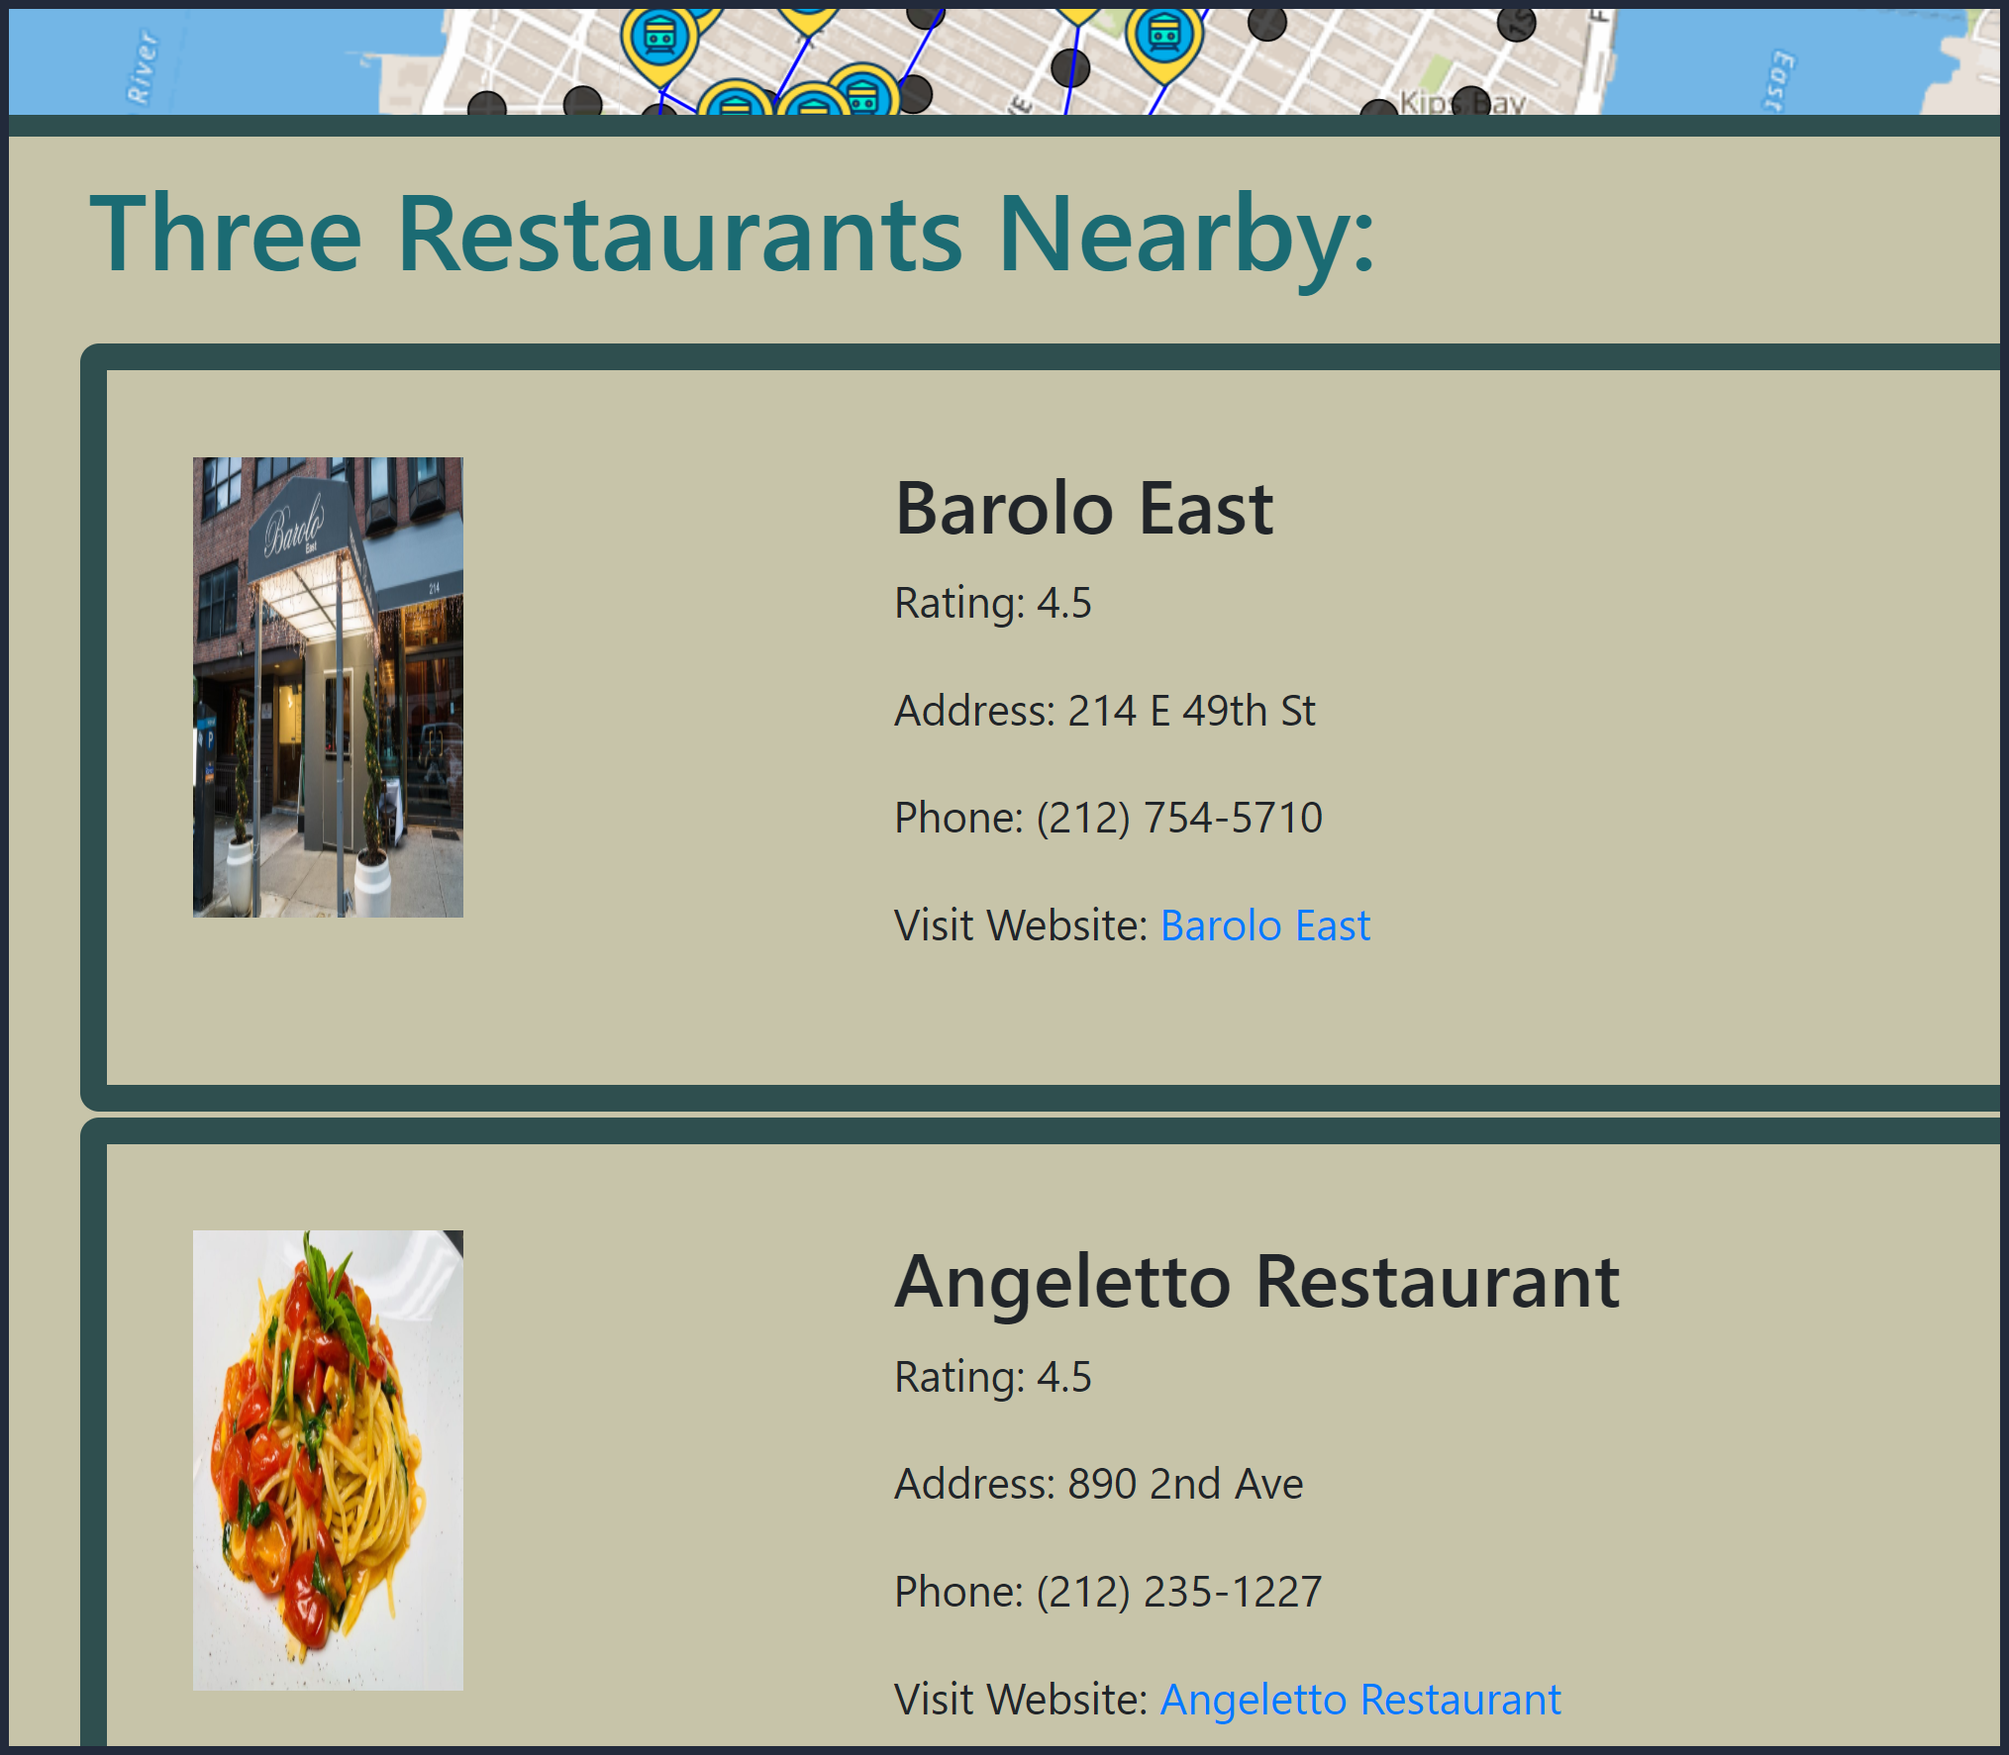
Future State
User selects a bike station nearby, or any starting-station.
App shows the 10 most traveled to destination-stations from that starting-station (in varied purple). User then selects any destination-station to see nearby attractions.
App lists attractions within a half of a mile of the selected destination-station…providing the user with stronger incentive to rent a bike and make a trip.

Slide 6
Closing the Gap(s)
Improve the Citibike app by enabling features that will allow renters to view and select:
Restaurants
Attractions
And many more activities along their route.
Listing the most popular destinations and the attractions nearby, will further entice customers to rent a bike and make the trip.

Slide 7
GOAL
To develop an app that explores bike sharing systems in NYC and popular trip destinations from particular stations, lists nearby attractions, and further encourages bike rentals.

Slide 8
proposal
Used the tools such as:
Python
MongoDB
JavaScript
Leaflet and MapBox
HTML and CSS
Used bicycle station data that displays frequent start and stop stations, then we can match those stations on a map to specific coordinates.
Through a web scrape, we can display matching popular destinations in those areas.

Slide 9
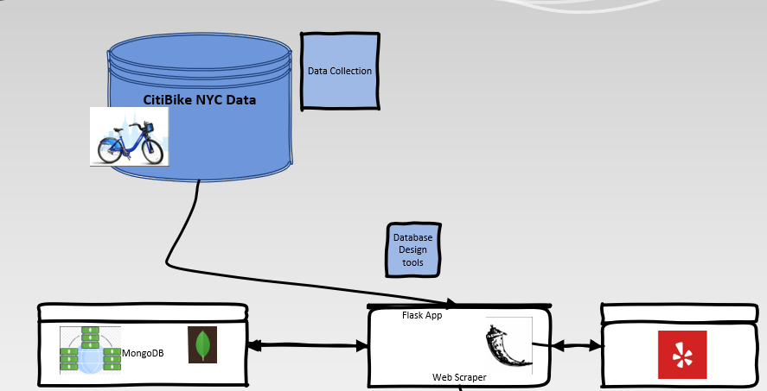
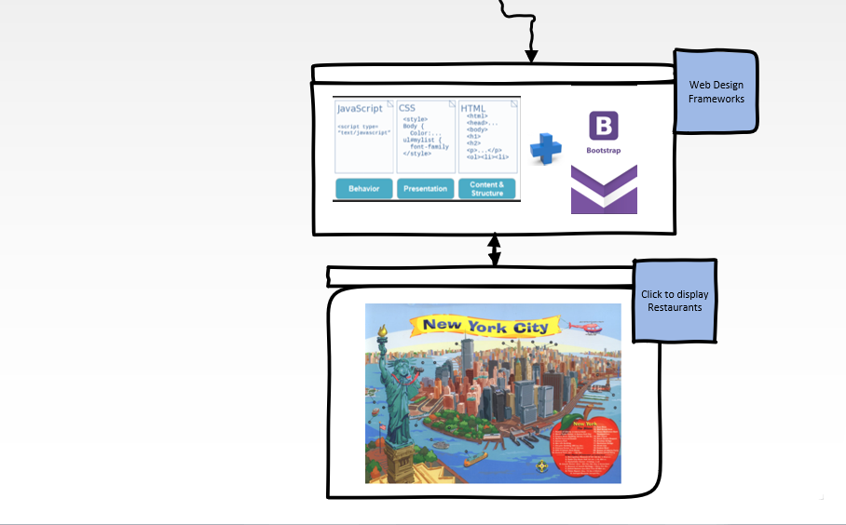
Workflow diagram

Slide 10
Data collection and curation
Collected Data from the CitiBike website
A huge task was to curate and prepare the data
Writing codes in Python to filter the gigantic Citibike CSV, hence giving us significantly smaller collections in our MongoDB
All unique stations with lat/lng
List of unique stations with three restaurants for each one
10 most popular destination stations from each station
Static database collections were chosen for a significantly faster loading app
The cost of not having live data was deemed minimal, as the need for live data for this application was not essential (business data not changing on that fine of a scale
Database collections can easily be updated periodically throughout the year

Slide 11
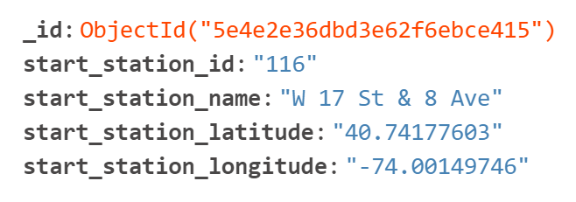
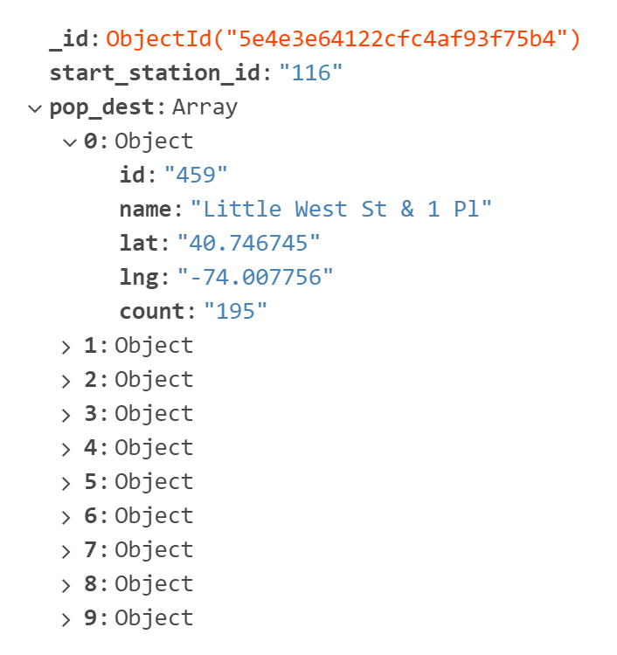
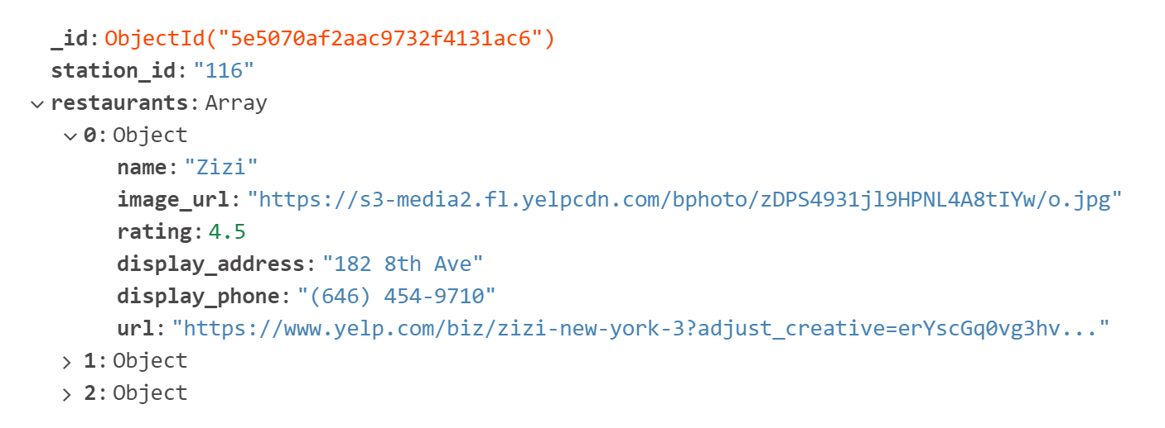
Collection Examples
All unique bike stations containing ID, NAME, LATITUDE and LONGITUDE
Used to plot base map containing all bike stations
All bike stations containing ID and the 10 most popular destination stations from each starting station
Used to plot overlay of the 10 most popular destination stations
Overlaid destinations will vary in color and opacity based on relative popularity
All bike stations containing ID and attractions within a half mile radius of each bike station
Used to list attractions below map for the chosen destination station

Slide 12
Roadblocks and workarounds
Roadblocks
Workarounds
Could not grab a list of restaurants unable to tie it with the coordinates.
Program scraped only the first page, yielding 16 results.
Results produced the name of the restaurant and neighborhood, not the exact location with coordinates.
Using a YELP API
Queried List of Places with specific coordinates
Able to query based on Coordinates to a range and half mile radius
Narrowed scope
Settled on clicking stations and retrieving information from yelp on top restaurants
Attempted to scrape from TripAdvisor.com
Matching of specific coordinates of popular bike stations to popular destinations
Too specific and too much data
Must overlap coordinates of bike stations into neighborhoods, then scrape from there

Slide 13
DISCOVERY
Data Collected from Examining CitiBike Data
Bikes activities were higher in the early morning and afternoon during the rush hours
Bike stations were located near the Grand Central Station – a commuter rail terminal
Peak originates between the hours of :
6:00 AM – 8:00 AM
4:00 PM – 7:00 PM
Data Collected from Executing App
Top Restaurants in the bike station/neighborhood

Slide 14
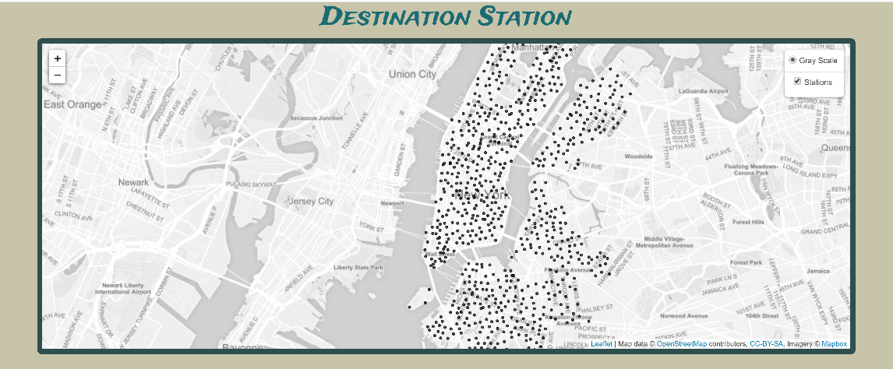
Proof of concept

Slide 15
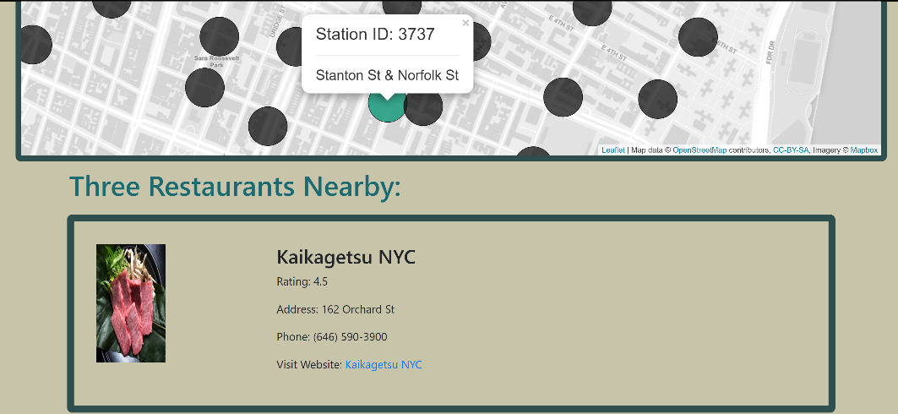
PROOF OF CONCEPT

Slide 16
Demo

Slide 17

QUESTIONS?

